Slide 1
How to ANOVA
Like your advisor/friend who uses SPSS

Slide 2
The Problem
ANOVA has several different mathematical forms → but most of psychology has adopted one type
However, it’s not totally obvious which type R is doing.

Slide 3
Math Explained
Type 1 – sequential sum of squares
Test IV 1 first
Add in IV 2, given IV 1 is already accounted for
Add in Interaction, given IV 1 and IV 2
Similar to hierarchical regression
Means that the order of IVs matters

Slide 4
Math Explained
Type 2 – assumes no significant interaction
Test IV 1, given IV 2
Test IV 2, given IV 1
Similar to a simultaneous regression
More power if interaction is not significant

Slide 5
Math Explained
Type 3 – most commonly used
Test for IV 1, given IV 2 and interaction
Test for IV2, given IV 1 and interaction
Test for interaction, given IV 1 and IV 2

Slide 6
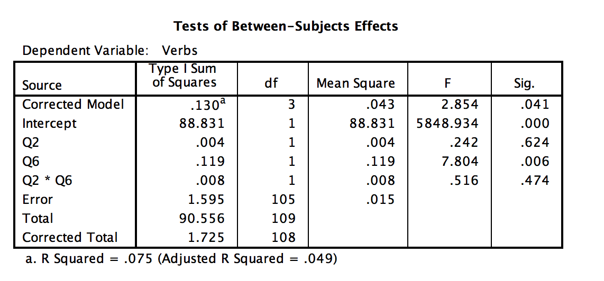
Type 1 SPSS

Slide 7
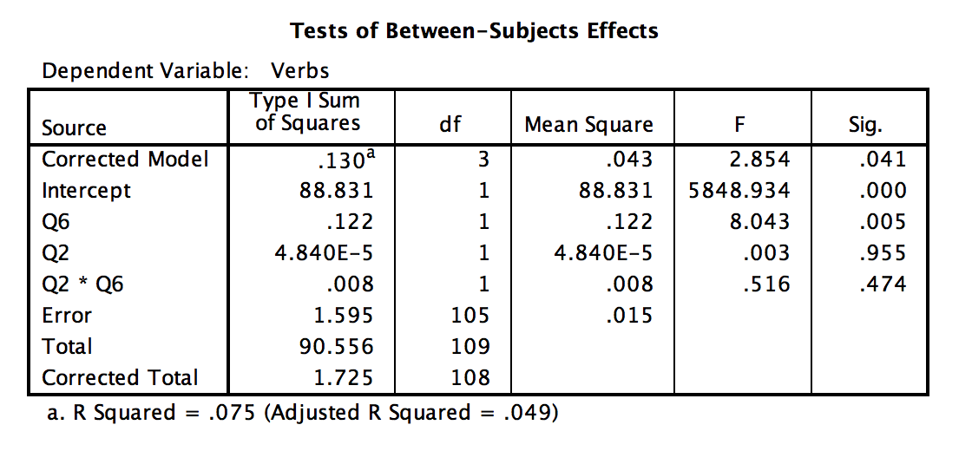
Type 1 SSPS

Slide 8
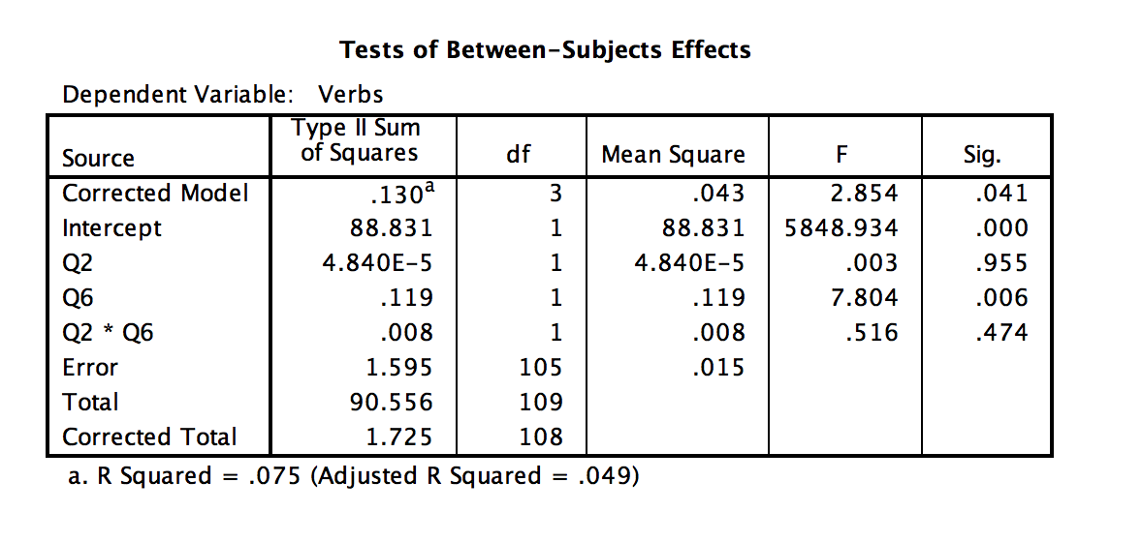
Type 2 SPSS

Slide 9
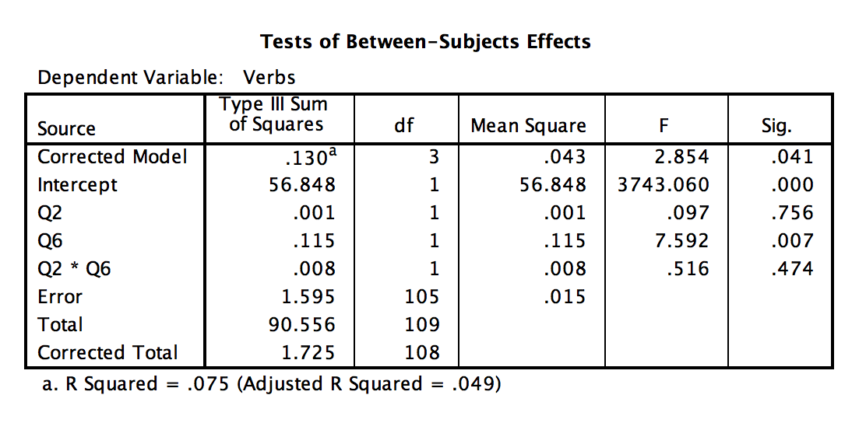
Type 3 SPSS

Slide 10
Summary
 | Type 1 Q2 | Type 1 Q6 | Type 2 | Type 3
Q2 | .624 | .955 | .955 | .756
Q6 | .006 | .006 | .006 | .007
Q2*Q6 | .474 | .474 | .474 | .474

Slide 11
How to R
Using the aov function and taking a summary of the output.
output = aov(Y ~ X, data = data)
summary(output)

Slide 12
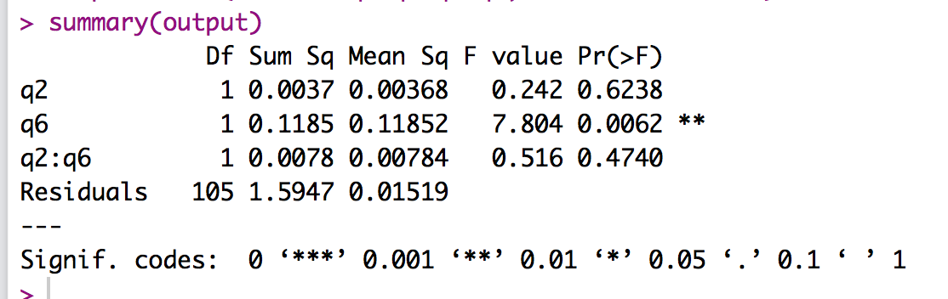
AOV + Summary
Type 1 SS with Q2 First

Slide 13
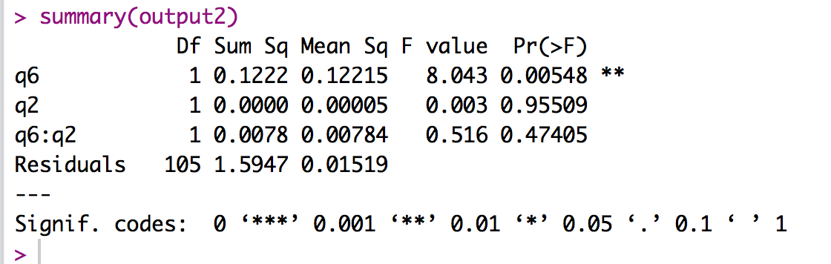
AOV + Summary
Type 1 SS with Q6 First

Slide 14
So what to do?
Option 1:
Use the Anova function in the car library, where you can specify the type.
Anova(output, type = “2”)
Anova(output, type = “3”)

Slide 15
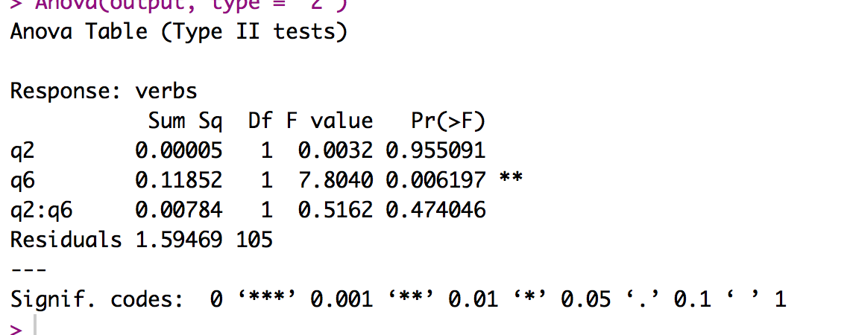
R Type 2

Slide 16
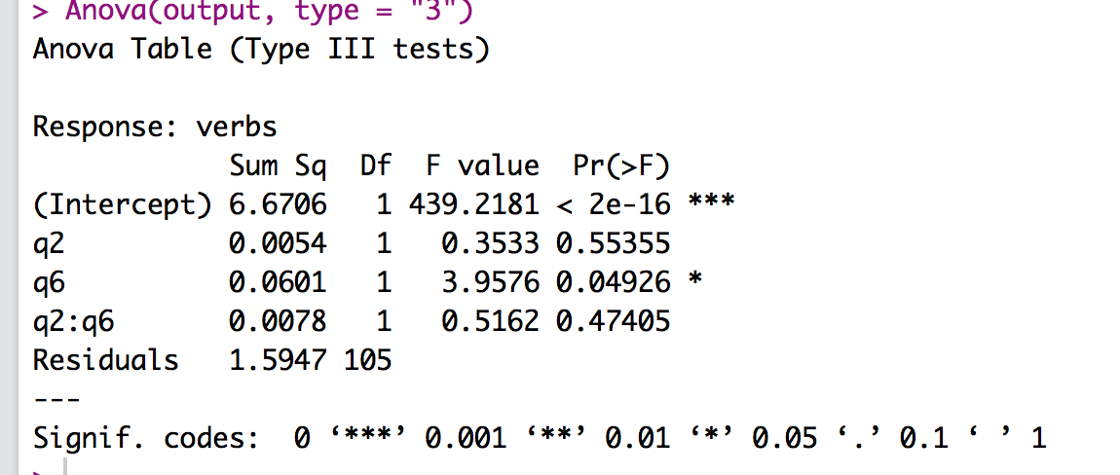
Wait a second …
EEK! Ordered factors because regression.

Slide 17
How to fix it!
Use the options command to set up contrasts.
options(contrasts = c("contr.sum", "contr.poly"))
Then run your Anova.

Slide 18
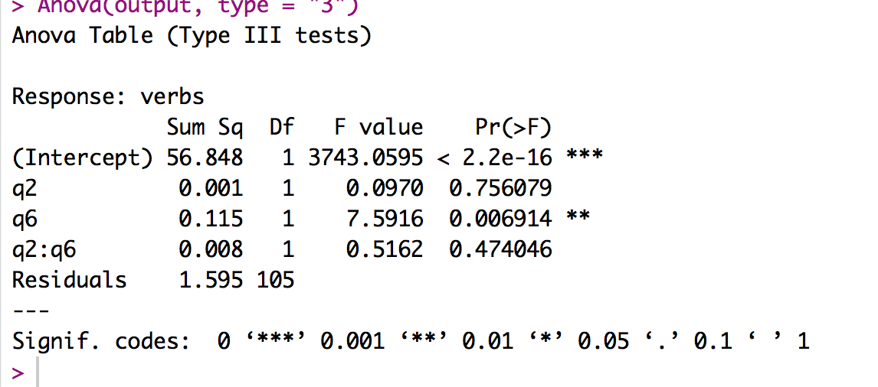
R Type 3

Slide 19
A Simpler Solution
Use the ez package and run ezANOVA
ezANOVA requires a participant number.
ezANOVA(data = data,
wid = partno,
dv = DV,
between = .(IV, IV),
detailed = TRUE,
type = 3)

Slide 20
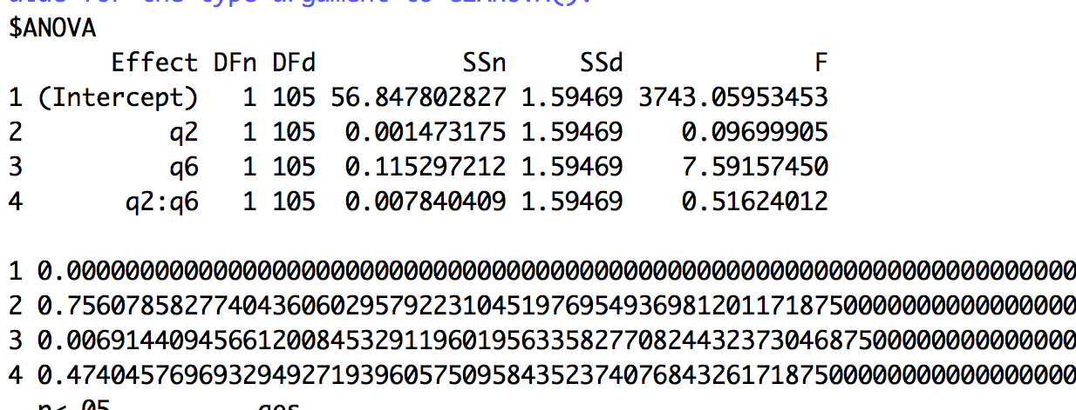
EZ Output

